Slide 1







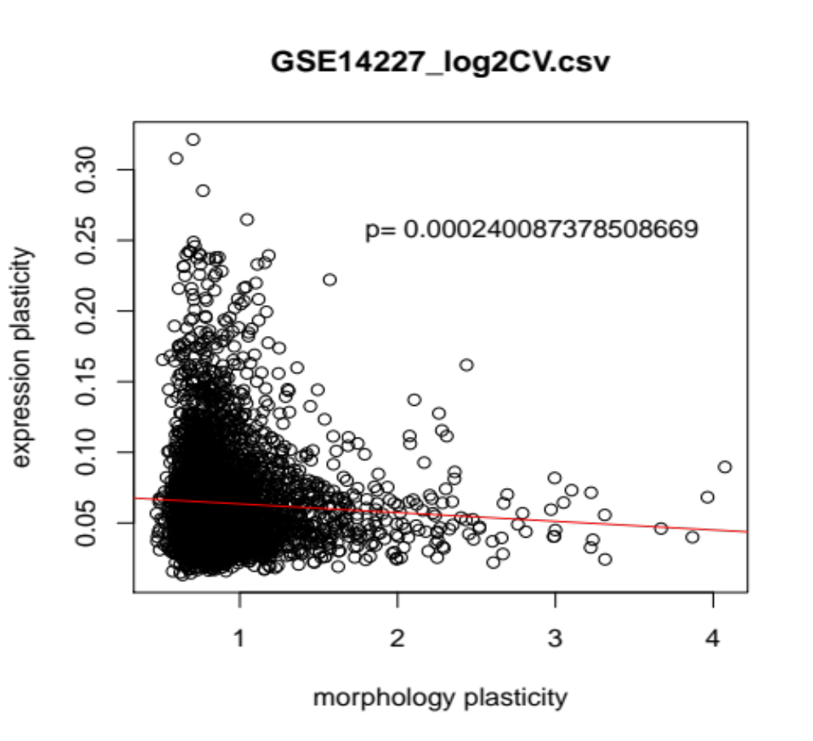



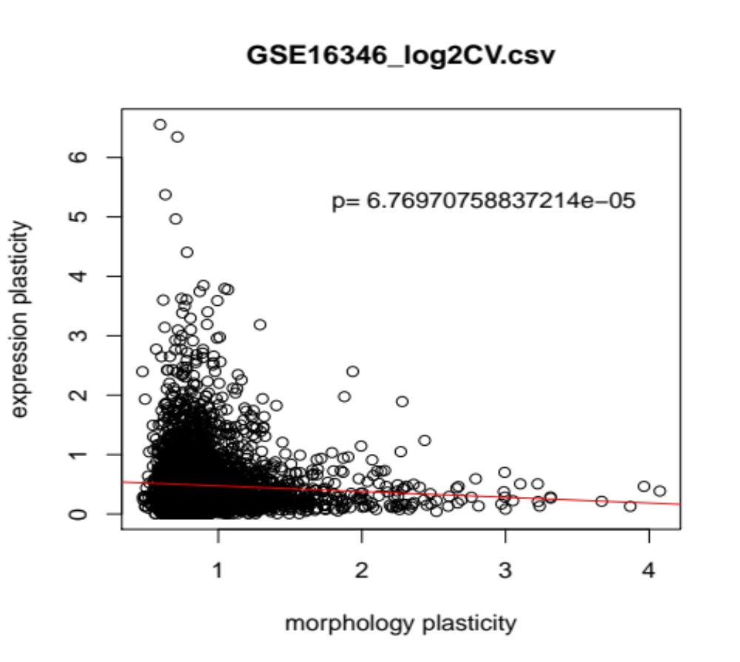


Is Robustness Connected to Cellular Aging in Yeast?
Keyana Scott
Dr. Hong Qin Ph.D., Biology Department
Introduction
Materials and Methods
Results
In order to understand the mechanisms of aging as accurately as possible, the organism Saccharomyces Cervisiae was observed because of its similar complex internal cell structure to higher-level eukaryotes In yeast Saccharomyces cerevisiae,aging is known as replicative life span or RLS; replicative life span is determined by the number of cell divisions that occur prior to senescence (when diploid cells can no longer divide.)
I studied the effect of robustness on RLS in S. cerevisiae. As a cell’s network robustness decreases, it will be less able to adapt against external perturbations. As a result, functionality of protein activities are depleted.
I hypothesize that robustness and several different proxies will be correlated to replicative life span in Saccharomyces Cerevisiae. The robustness proxies examined are morphological plasticity robustness and gene expression plasticity. These proxies are a way to measure the robustness of a system.
Using R and an open source software called R-studio, I performed linear and multiple regression analysis on the different variable factors that comprise robustness and cellular aging.
I was not able to compare the robustness proxies to replicative lifespan because the data for replicative lifespan, specifically the standard deviation was not readily available. As a result, I compared the two proxies (morphological plasticity and gene expression plasticity) to each other.
From this comparison I found out that morphological plasticity and gene expression plasticity are correlated and ultimately good proxies to measure robustness.
Future Directions
Although I was ultimately not able to prove my hypothesis that robustness is correlated with replicative lifespan throughout this experiment, in the very near future I will be able to.
Since I have already determined two proxies that accurately measure robustness, once the standard deviation for lifespan is attained I will be able to see if robustness is correlated with lifespan.
Summary
Fig. 1 Gene expression data set number 15 has a good correlation to morphological plasticity due to the fact that its p value is less than .05, making this gene expression data set proxies good to use when trying to determine if robustness is correlated to lifespan.
Objectives
This study examined the robustness proxies morphological plasticity and gene expression plasticity in order to determine whether or not they are good proxies to measure robustness.
Determining if these proxies are good measures of robustness will allow me to accurately determine if lifespan is correlated to robustness.
Acknowledgements
Fig. 2 In this figure, gene expressiion does not have a good correlation with morphological plasticity

